Slide 1
Welcome to 8th Grade
The last year of middle school!

Slide 2
8th Grade Assessments
FLDOE Required F.A.S.T.
3 ELA/Math Tests per year, 1 Science, & 1 Writing
PM 1 ELA & Math in September
PM 2 ELA & Math in December/January
Writing in April
PM 3 ELA, Math, Science in May
EOC Assessments in May: Civics, Biology, Algebra, & Geometry
We are here to help!
Tutoring
Academic Lunch
Remediation

Slide 3
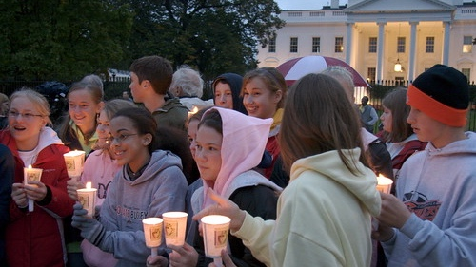
8th Grade Washington DC Trip
Greenlight Group Tours
Jan 2nd-6th, 2024

Slide 4
Who can attend?
Any MMS 8th grader who has not received a referral starting on Oct. 2, 2023.
Students must have regular attendance and be passing all subject areas at 2nd quarter interim report and be on track to pass for the first semester.
Must have no less than an 70% in their 8th grade Civics course.

Slide 5
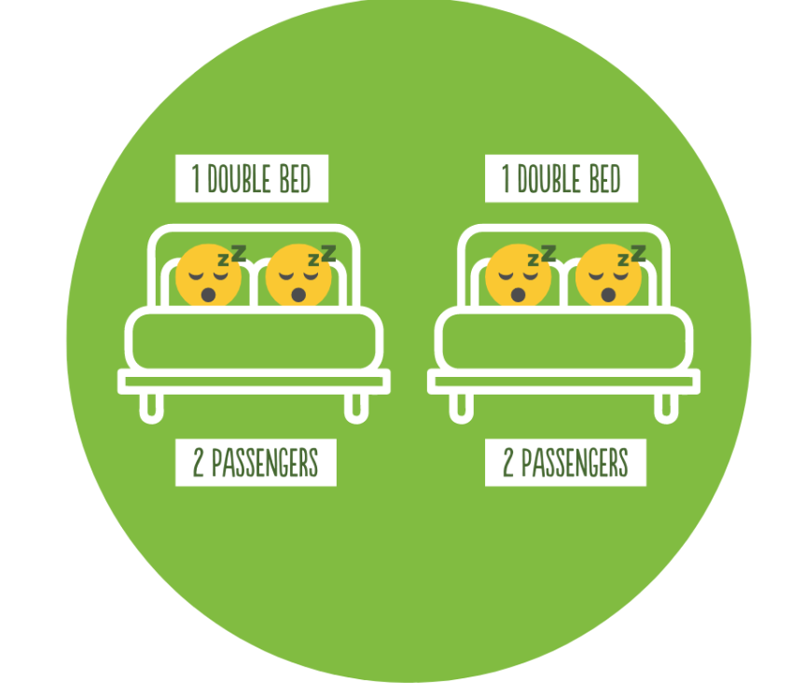
What is included & cost:
Motor Coach Transportation to and from DC
3 nights lodging at hotel
Museum admissions and guided tours
Dedicated tour managers
Group Photo
Meals
Name badge with emergency phone numbers
Two nighttime security guards at hotel for student safety
A commemorative scarf

Slide 6
Payment Schedule
Quad(Student Package): $1,343 per person (4 in a hotel room - 2 double beds)
*Traveler responsible for finding roommate also paying the double occupancy rate*
Payment Date | % | Student Estimate | Payment Description
10/20/2023 | 25% | $335.75 | First Installment
11/3/2023 | 25% | $335.75 | Second Installment
11/18/2023 | 50% | $671.50 | Final Balance

Slide 7
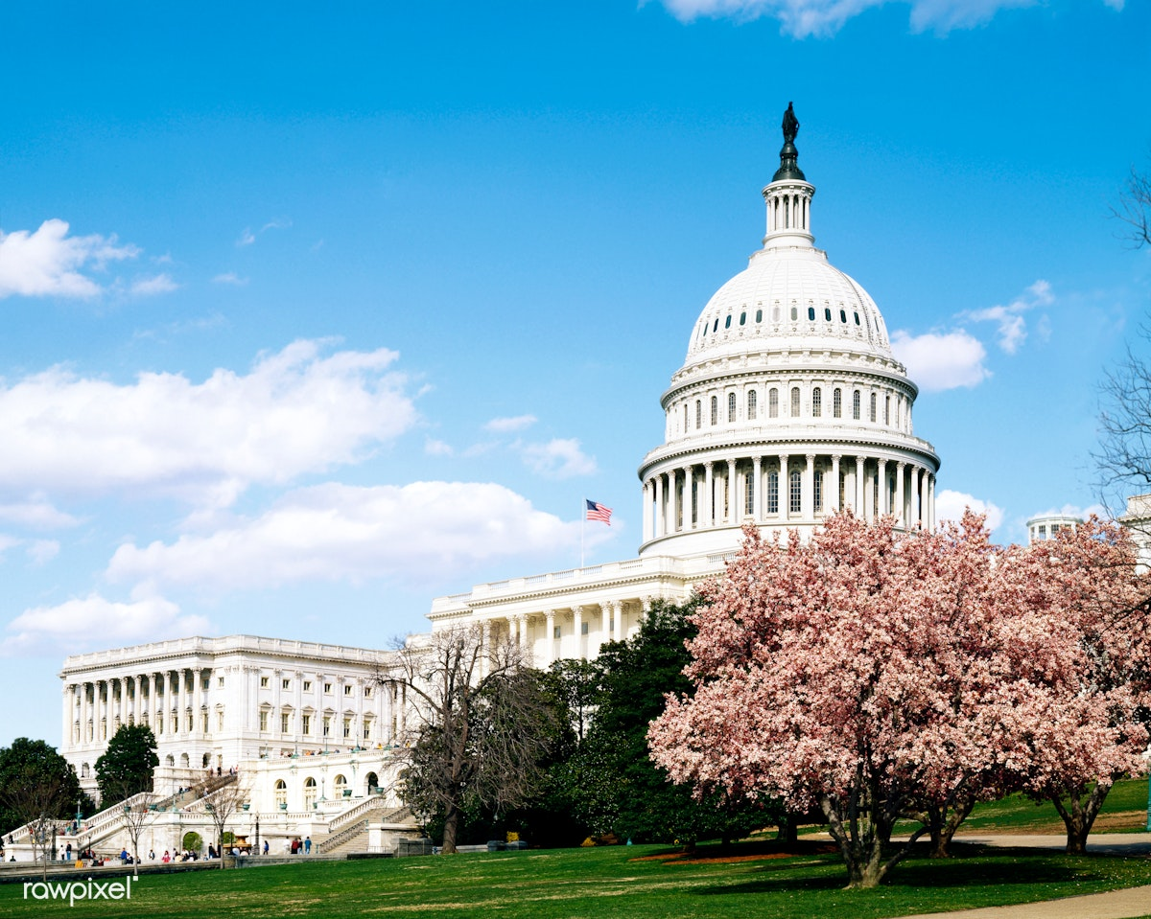
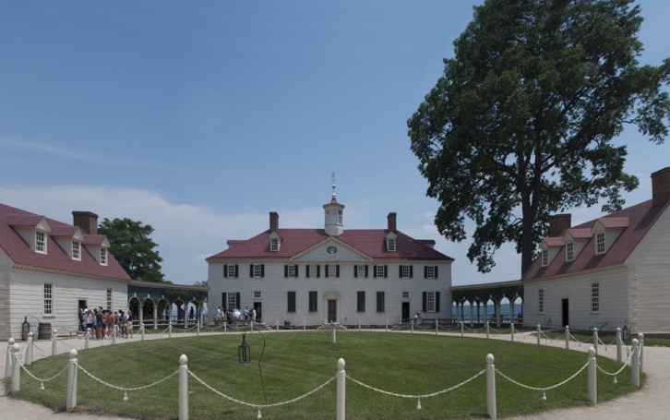
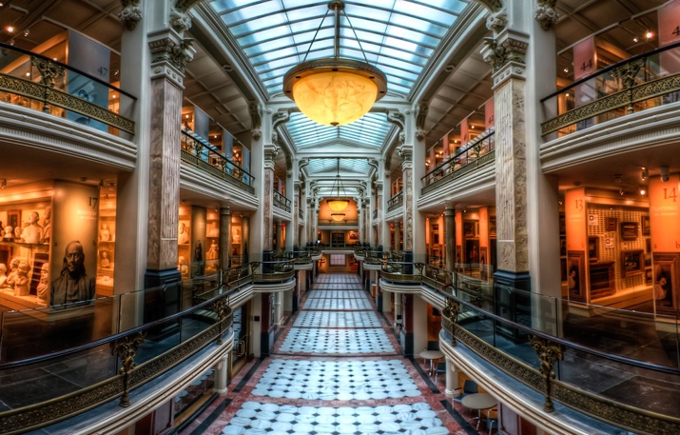
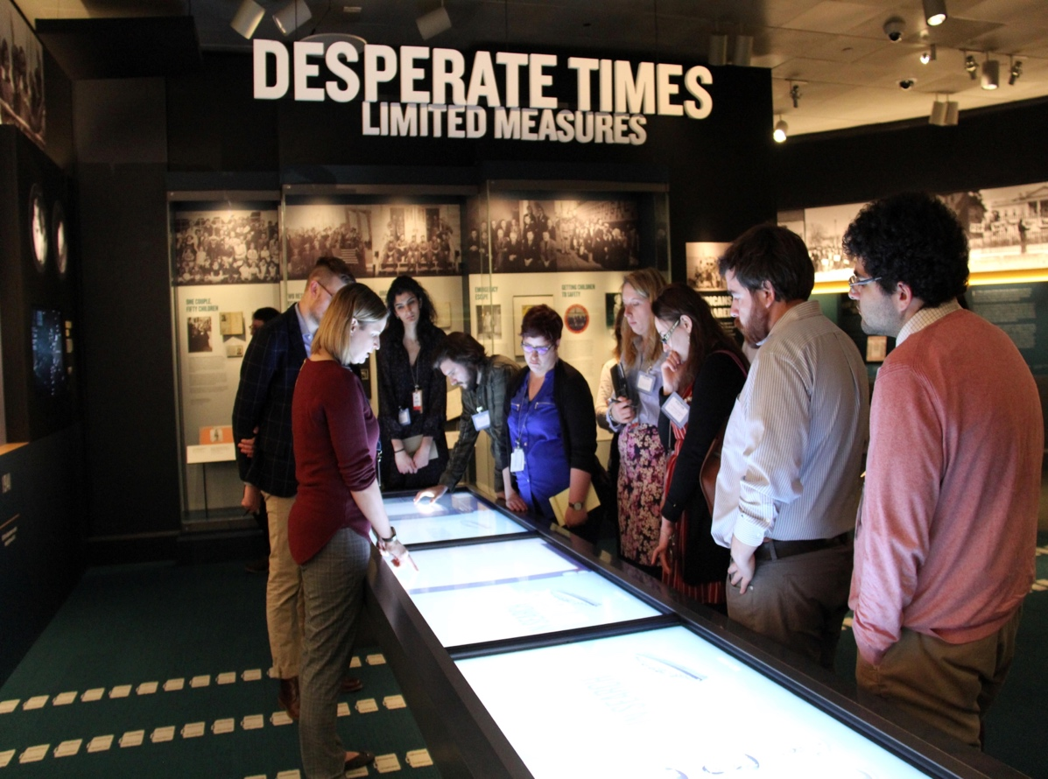
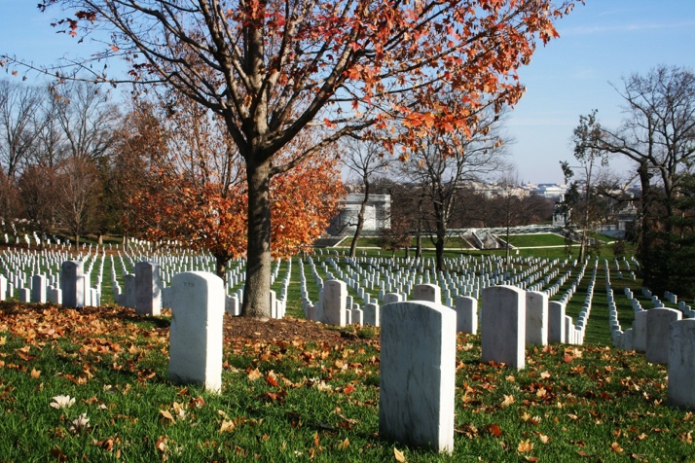
Locations Visited:
Mt. Vernon
Washington Monument
White House (exterior)
Lincoln Memorial
Veterans Wall
WW2 Memorial
Korean War Memorial
Library of Congress
Arlington National Cemetery
Holocaust Memorial Museum
U.S. Capitol Tour
African American History Museum
Smithsonian Museum of American History
For more info out trip and the itinerary please watch the video from Greenlight Tours here:
https://youtu.be/mjLpU2IByzo

Slide 8
Parent Chaperones
Will be accepted on a first come first registered basis.
First installment would need to be paid at the time of registration
Students will be given priority for the trip if capacity becomes an issue

Slide 9
Departure & Arrival Times:
Tuesday, January 2nd
Friday, January 5th
6:00am Buses Arrive at Murray Middle School
6:30am Depart for Washington, D.C.
6:30pm Dinner Cruise with DJ on the Potomac River
10:00pm Depart for home (bags will be packed onto busses in the am)
Arrive back at Murray at noon on Saturday, Jan. 6th.

Slide 10
WHAT TO PACK?? long sleeve t-shirts sweaters/sweatshirts warm jacket/coat gloves/mittens warm hat waterproof jacket long pants leggings or long underwear warm socks and sturdy shoes phone and charger toiletries lip balm

Slide 18
8th Grade Formal Dance Date: May 17th Cost: $25 Sponsored by the PTO
8th Grade Week
May 20 - 24
Who can participate?
Effective Jan. 8, 2024, MMS 8th graders with:
No OSS
No more than 2 days of ISS
No more than 2 discipline referrals
Regular attendance (including tardies)
On track to pass all subject areas/classes after 3rd quarter
Must have no less than a 70% in their 8th grade Civics course.
8th graders must consistently display our BARK expectations.

Slide 19
8th Grade Week
May 20 - 24
How much does it cost?
TBD
We would LOVE and APPRECIATE any donations!
What does it include?
8th Grade Breakfast
Admission to “Murray’s Got Talent” show
Field Day
Pizza Lunch
Movie & Concessions in Auditorium
Award Ceremony
Admission to Faculty vs Student Game
Yearbook Signing “Party”
Who can participate?
Effective Jan. 8, 2024, MMS 8th graders with:
No OSS
No more than 2 days of ISS
No more than 2 discipline referrals
Regular attendance (including tardies)
On track to pass all subject areas/classes after 3rd quarter
Must have no less than a 70% in their 8th grade Civics course.

Slide 20
Questions?
Email Ms. Pisano:
kimberlee.pisano@stjohns.k12.fl.us

