Slide 1
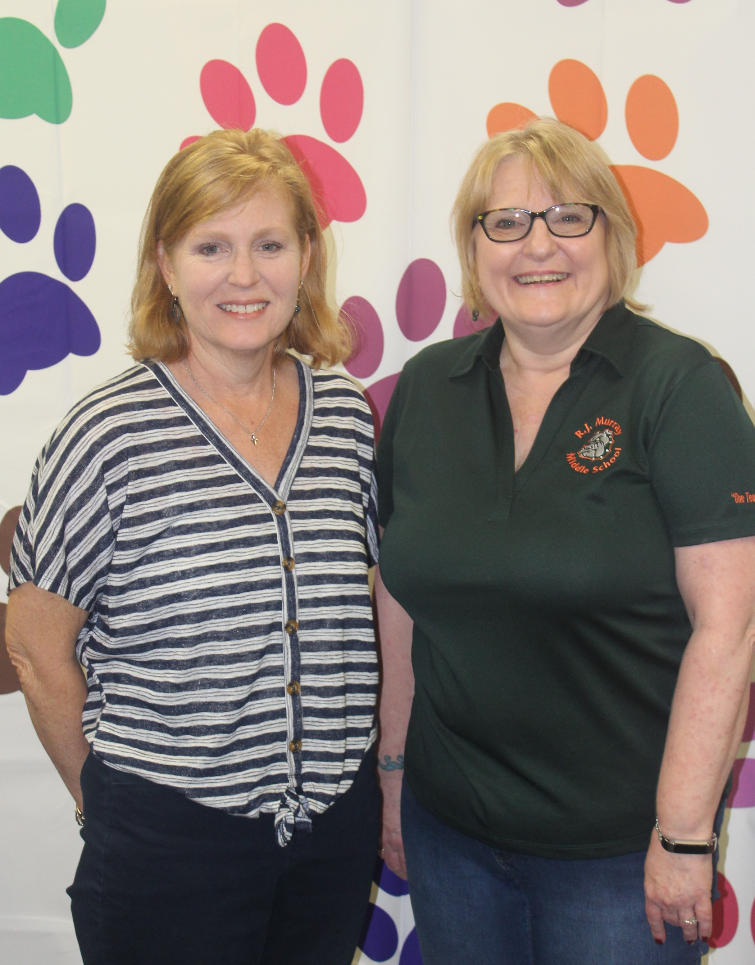
Ms. Stinson:
Media Specialist
Ms. Guthrie:
Media Assistant
Welcome to RJ Murray Middle School
Media Center

Slide 2
Safety First!

Slide 3
Library Safety Guidelines
Always wear your mask if social distancing isn’t possible while in the library
Maintain social distancing: look for floor marks and signs; do not pull extra chairs to tables.
Observe signs for safe computer use.
While browsing books on shelves: social distance as possible, wear your mask, use hand sanitizer before and after touching a book, DO NOT re-shelve books, put them on the carts labeled “Books to be Shelved.”
Ask Ms. Stinson or Ms. Guthrie for help if you are not sure what to do.

Slide 4
Let’s Explore the
Library!

Slide 5
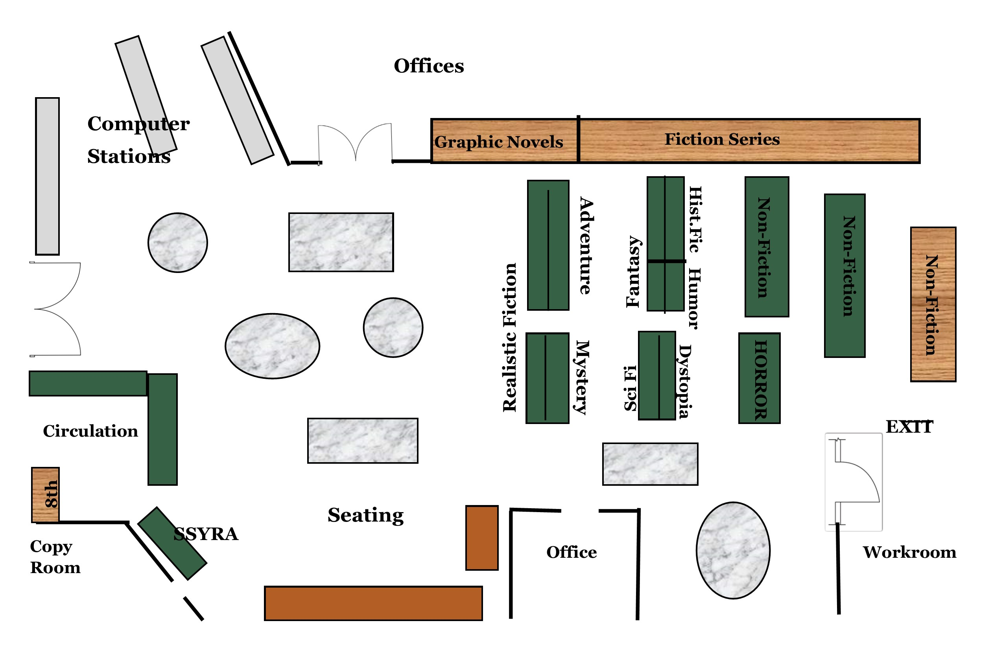

Slide 6
Fiction (chapter books- Fake)
Arranged by Genre (type of story) and Color Coded
Realistic Horror(Red Stripe)
Mystery Graphic Novels
Adventure Fiction Series (Blue Stripe)
Fantasy
Sci-Fi
Humor
Historical
Dystopia
Fiction is arranged by author’s last name within each genre.

Slide 7
NonFiction ( real-factual)
Nonfiction arranged by Dewey Decimal Numbers.
Use Destiny to look up what you want
Look for signs or ask for help finding topics.
Biography section is arranged by subjects’ last name.

Slide 8
Browse library books virtually
The next few slides take you through accessing and finding books using Destiny, the library computer system.
Use Destiny to select books, and you can create a “shopping cart” of the books you want. The books will be ready for you to pick up or be brought to your classroom.
You can also “check out” eBooks through Destiny!

Slide 9
Click on Media Center from School Home Page to get to this page.

Slide 10
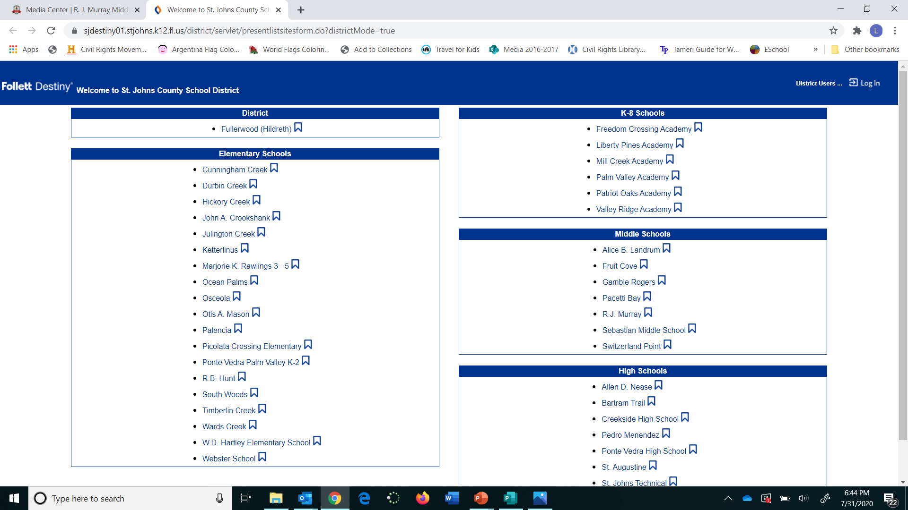

Slide 11
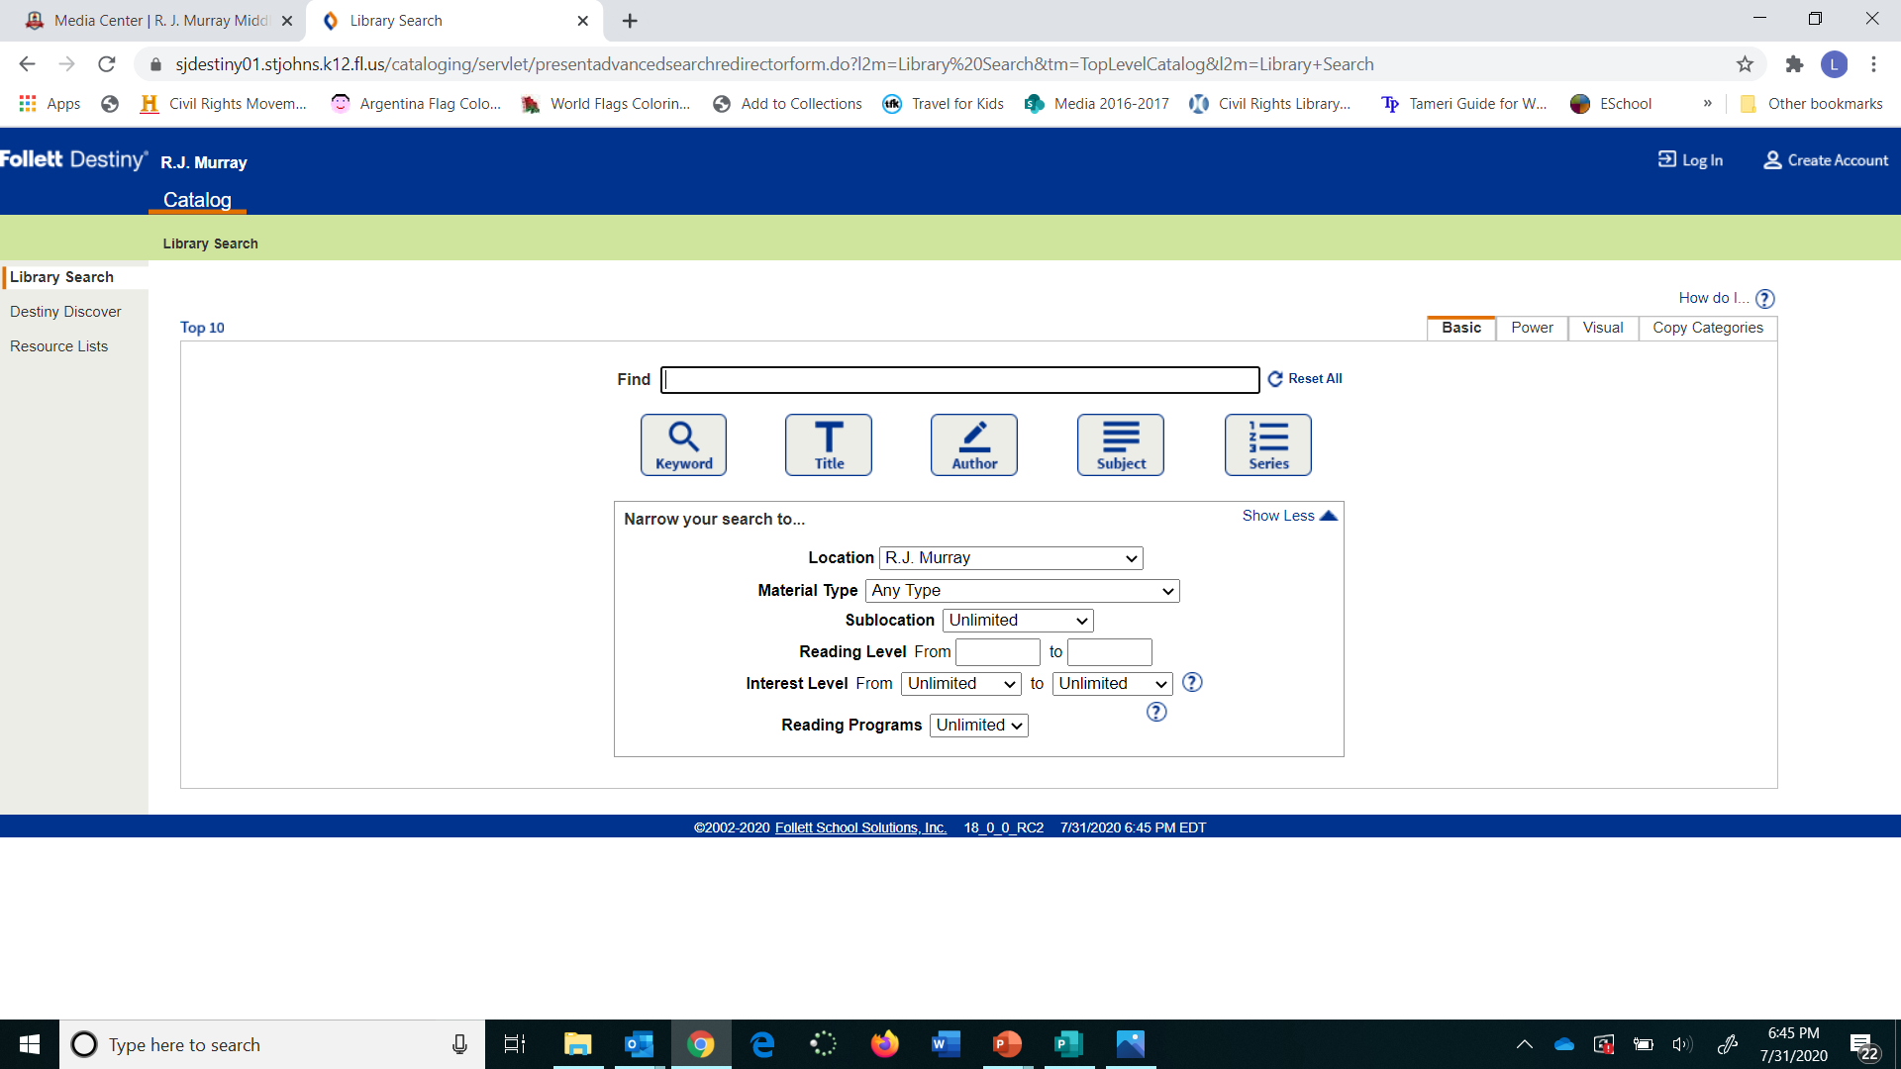
Log in with your Microsoft Username and Password
Search for Title, Author, Subject, etc.
You can specify Book or Ebook here.

Slide 12
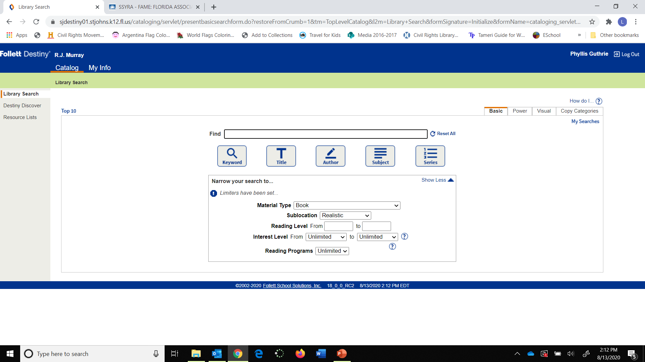
You can search by genre using sublocation

Slide 13
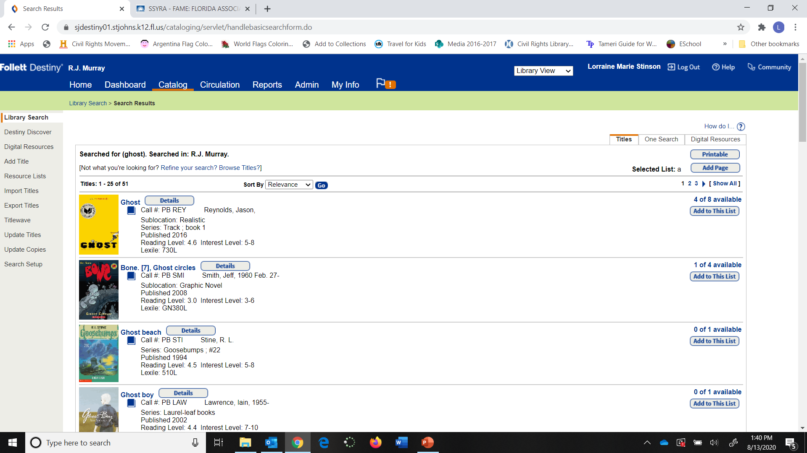
To Check out book, click on “Details”

Slide 14
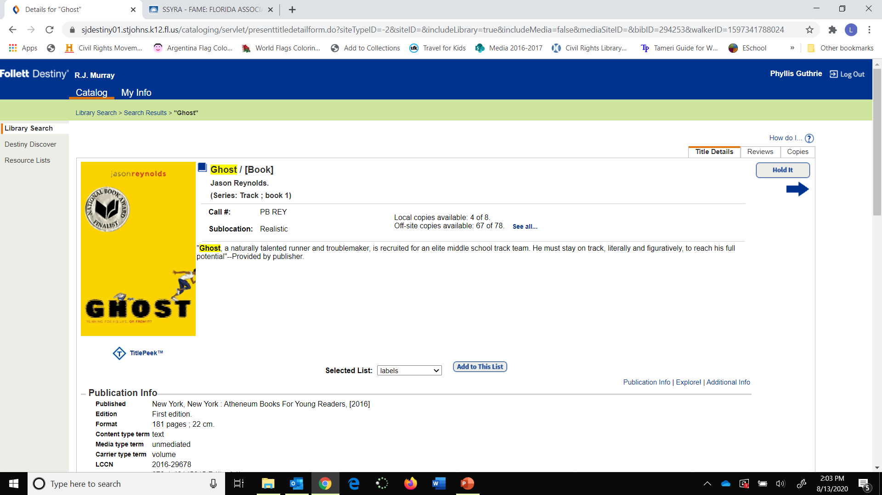
Click “Hold It” to check out when you aren’t in the library.

Slide 15
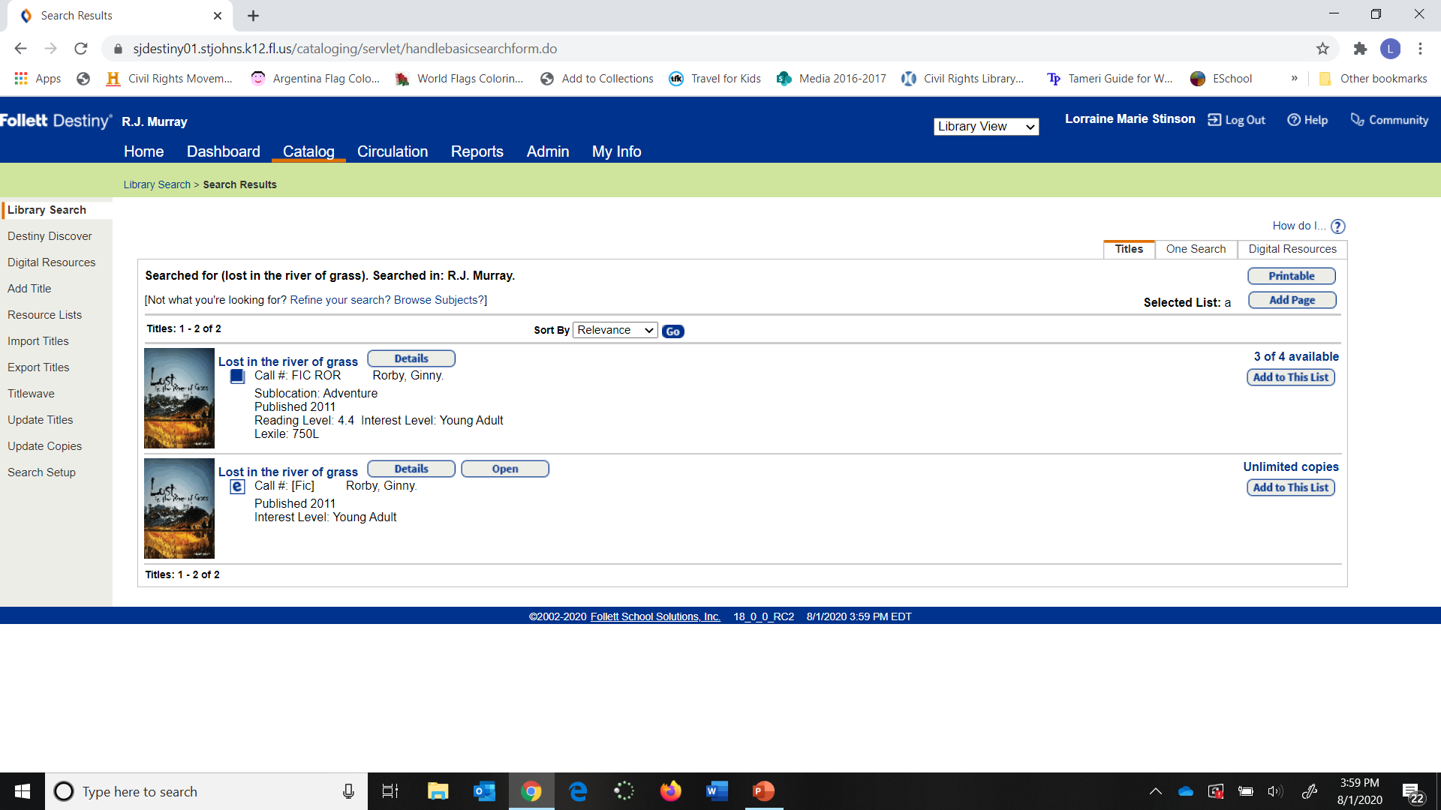
Ebooks have this symbol
Click open to check out ebook.

Slide 16
Things you need to know
You can check out 3 books at a time.
Book check out is for 2 weeks.
Books can be renewed
No overdue fines, but you will have to pay for or replace lost or damaged books.

Slide 17
Media Center Schoology Group
Join the Media Center Schoology group for more book trailers, book talks, and book club information!
Access Code: P6MX-G54F-K7S4Z
Be looking for information on our Virtual Book Fair coming soon!

Slide 18
SSYRA
Sunshine State Young Reader Award program is a big part of Murray’s media program.
Books are available for check out: one at a time, please. Ebooks are available for most of the 15 titles.
Battle of the Books: See Ms. Stinson or Ms. Guthrie if you would like to be part of the SSYRA book club and/or participate in Battle of the Books.
See SSYRA 6-8 Video on next slide

