Slide 1
Welcome to
RJ Murray Middle School
Media Center

Slide 2
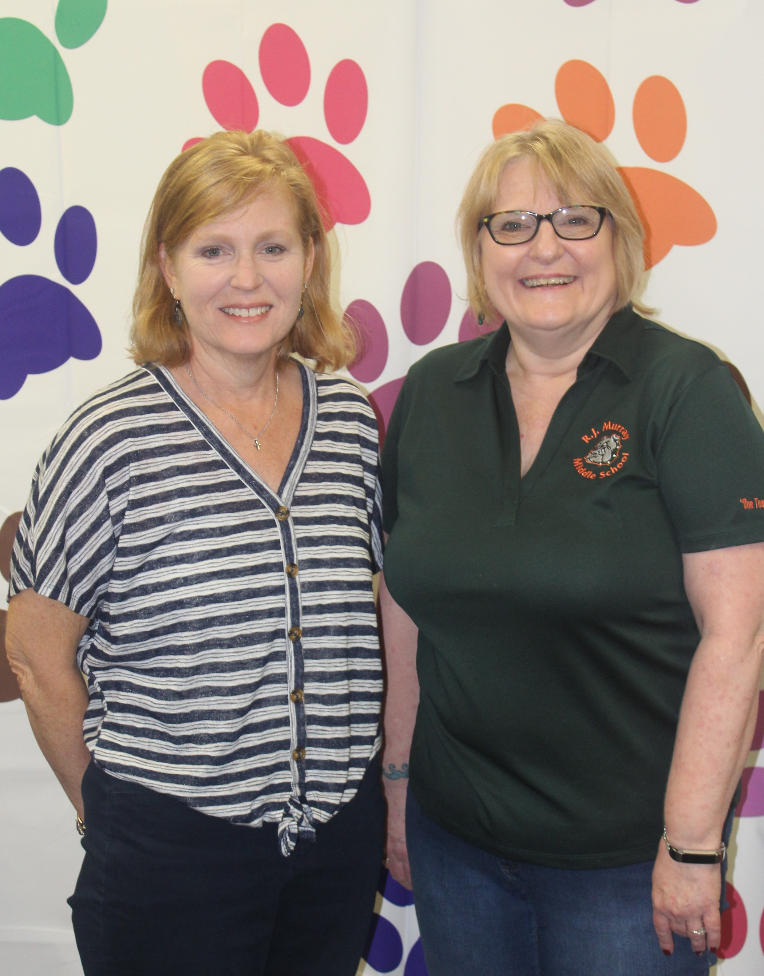
Ms. Stinson:
Media Specialist
Ms. Guthrie:
Media Assistant
Let’s Explore the
Virtual Library!

Slide 3
Browse library books virtually
The next few slides take you through accessing and finding books using Destiny, the library computer system.
Use Destiny to select books, and you can create a “shopping cart” of the books you want.
You will be notified when the books are ready to be picked up.
You can also “check out” eBooks through Destiny!

Slide 4
Click on Media Center from School Home Page to get to this page.

Slide 5
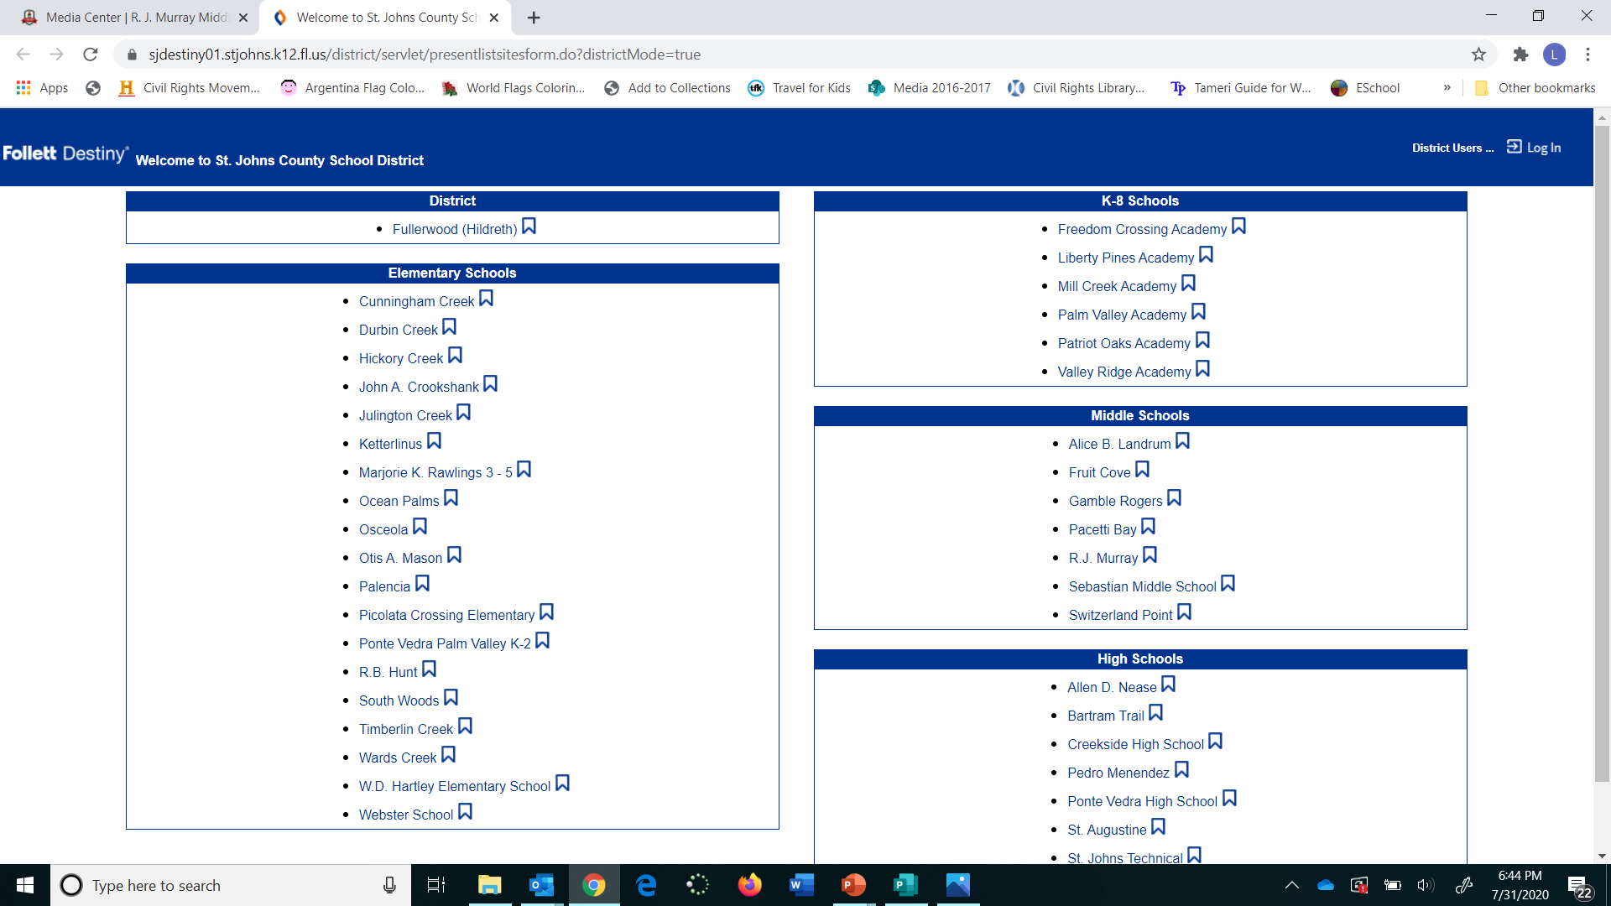

Slide 6
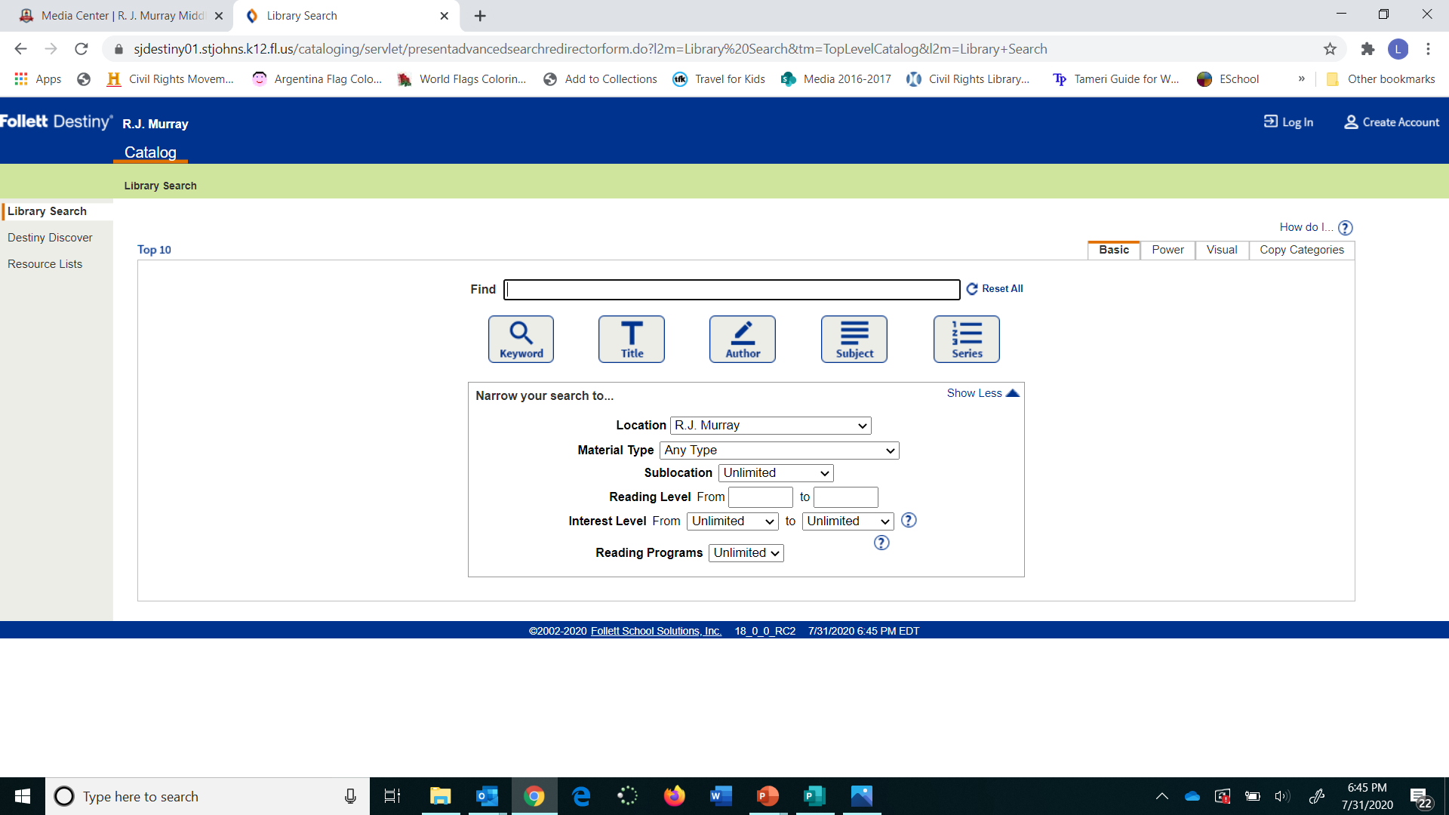
Log in with your Microsoft Username and Password
Search for Title, Author, Subject, etc.
You can specify Book or Ebook here.

Slide 7
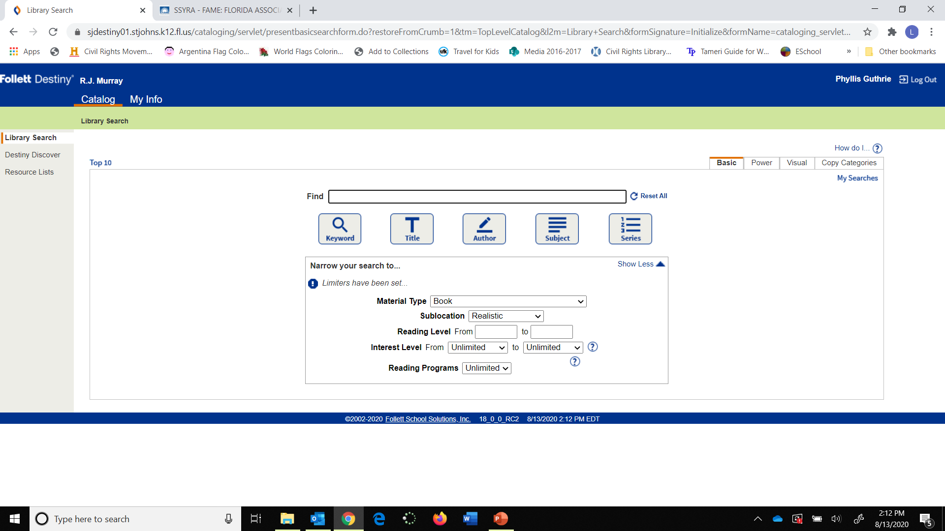
You can search by Genre by changing Sublocation.

Slide 8
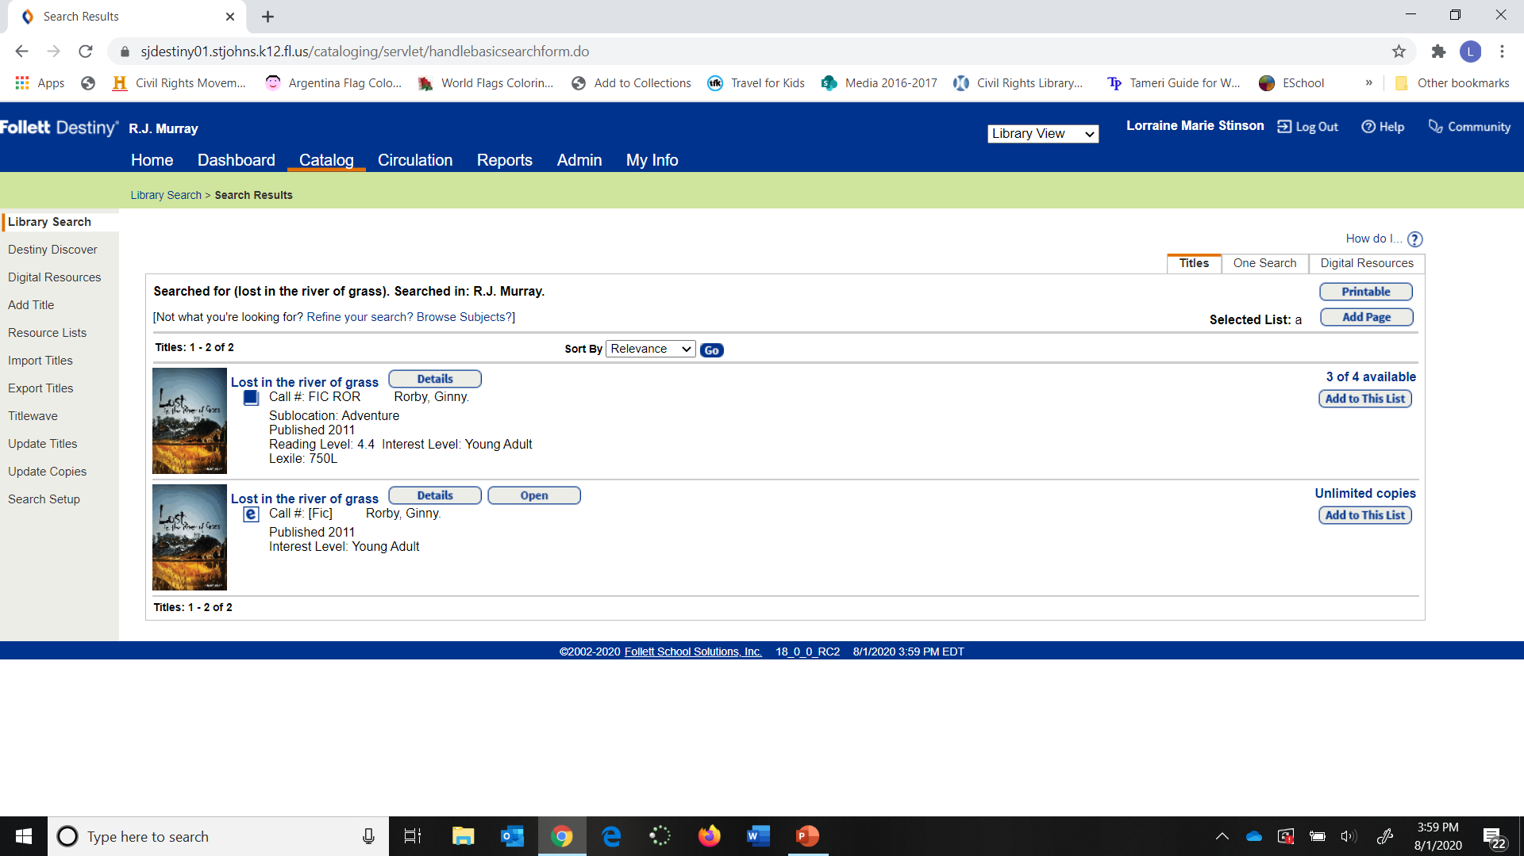
Ebooks have this symbol
Click open to check out book.

Slide 9
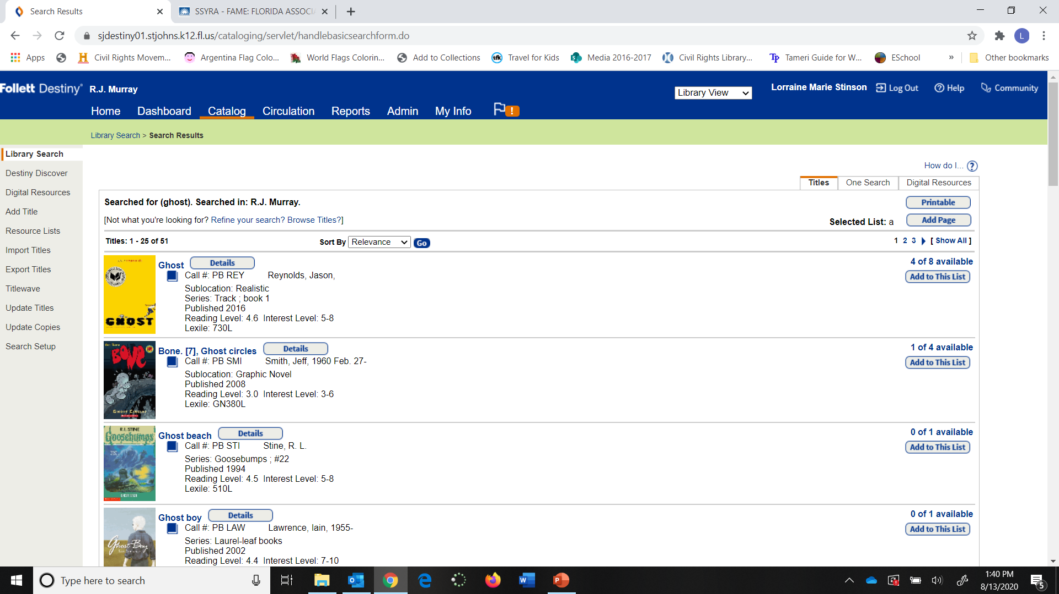
To Check out book, click on “Details”
Sublocation is the Genre.

Slide 10
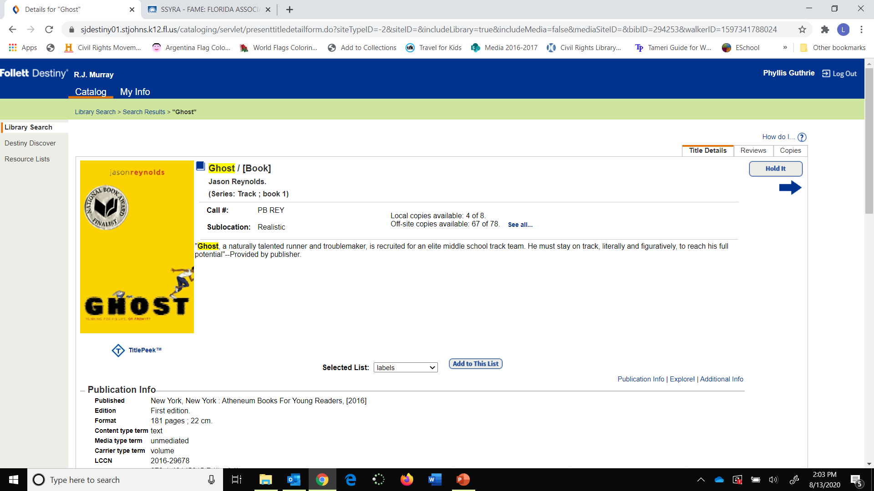
Click “Hold It to check out.

Slide 11
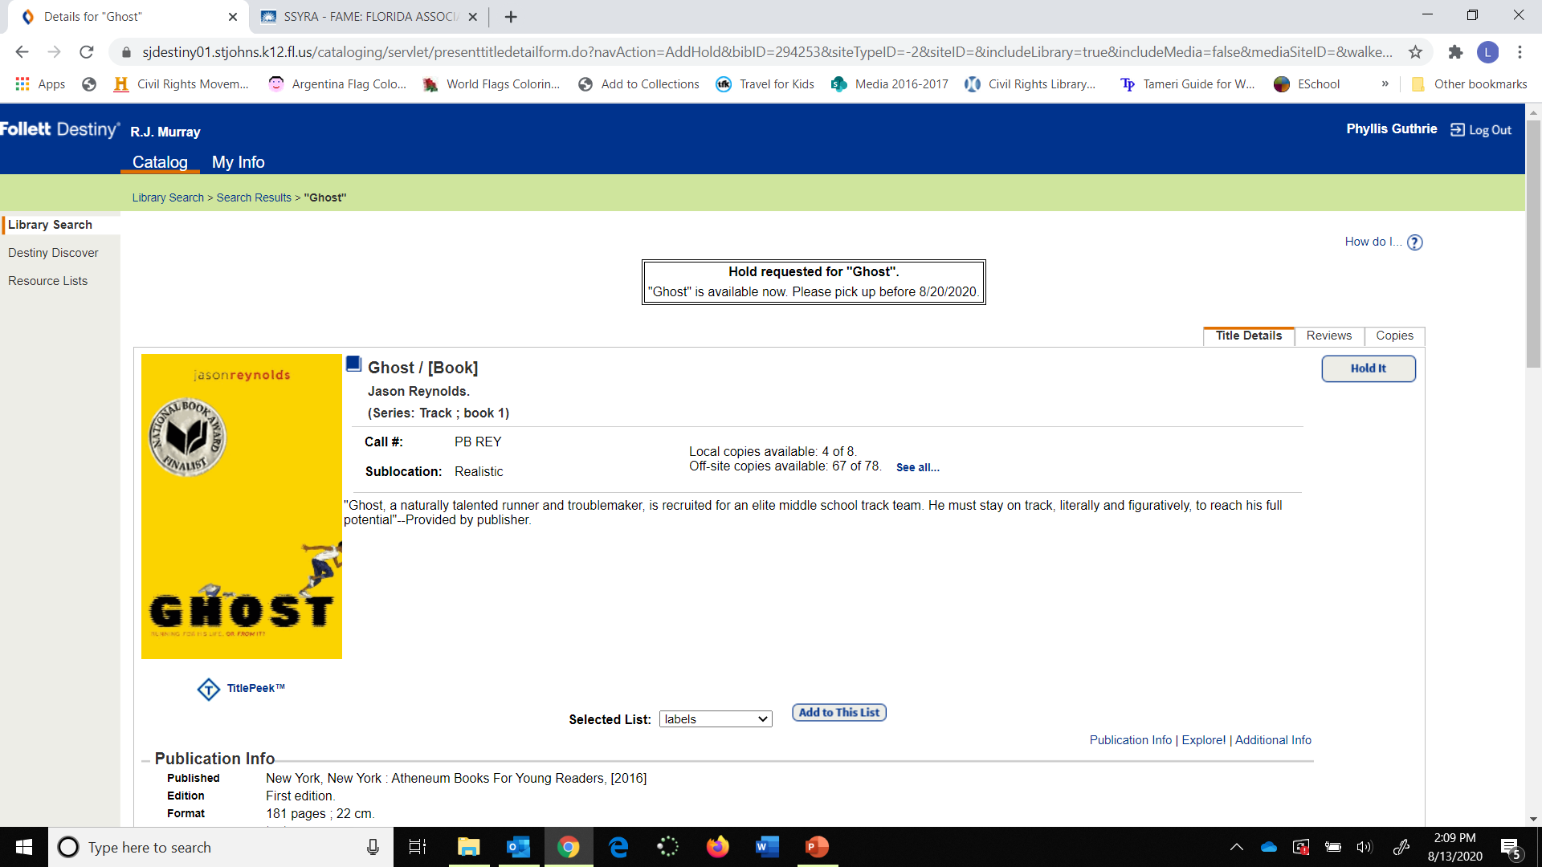
Ignore the pick-up date here, we will contact you with the date your books will be ready for pick up.

Slide 12
Click on “My Info” to see your list.

Slide 13
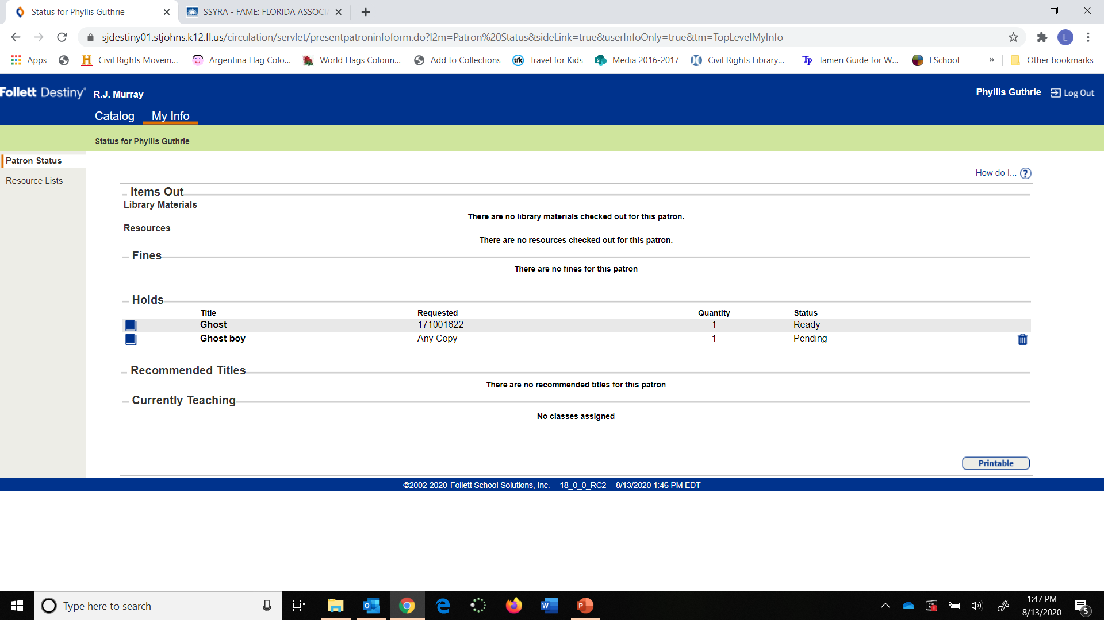
On this list one book is in and the other is checked out and has been put on hold. You would be notified what is available for pick up in the front office and when.

Slide 14
Fiction (chapter books- Fake)
Genre (type of story) and Color Coded and labeled Sublocation
Realistic Horror(Red Stripe)
Mystery Graphic Novels
Adventure Fiction Series (Blue Stripe)
Fantasy
Sci-Fi
Humor
Historical
Dystopia

Slide 15
NonFiction ( real-factual)
Nonfiction Call Numbers are Dewey Decimal Numbers.
Use Destiny to look up what you want
Biographies

Slide 16
Things you need to know
You can check out 3 books at a time.
Book check out is for 2 weeks.
Books can be renewed.
No overdue fines, but you will have to pay for or replace lost or damaged books.

Slide 17
Media Center Schoology Group
Join the Media Center Schoology group for more book trailers, book talks, and book club information!
Access Code: P6MX-G54F-K7S4Z
Be looking for information on our Virtual Book Fair coming soon!

Slide 18
SSYRA
Sunshine State Young Reader Award program is a big part of Murray’s media program.
Books are available for check out: one at a time, please. Ebooks are available for most of the 15 titles.
Battle of the Books: See Ms. Stinson or Ms. Guthrie if you would like to be part of the SSYRA book club and/or participate in Battle of the Books.
See SSYRA 6-8 Video on next slide

