Slide 1
SSYRA
2017 - 2018

Slide 2
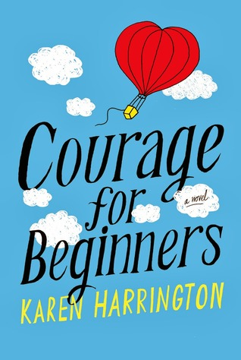
Courage for Beginners by Karen Harrington
If only Mysti could be a character in a book, then she would know how to deal with her mother, who is agoraphobic and unable to leave the house; with her best friend, who decides he’s too cool for her; and with all the changes and challenges in her life, that shift into focus when her father is hurt, and the pantry is slowly emptying. With the help of new friends, including the unflappable Rama Khan, Mysti finds the courage to change her own story
Framed! by James Ponti
Florian has just moved to Washington, D.C. He’s learning his way around using TOAST, which stands for the Theory of All Small Things, a technique he invented to solve life’s little mysteries. But when he teaches it to his new friend, Margaret, they uncover a mystery that isn’t little. Not little at all, but part of a much bigger picture!

Slide 3
The Girl in the Well is Me by Karen Rivers
Kammie just moved to a new town to escape her father’s mistakes. She just wants to be popular and make friends. So when Kammie agrees to the (fake) initiation activity that Mandy, Kandy, and Sandy require for her to be their friend, Kammie doesn’t expect to find herself at the bottom of an old abandoned well. Have Mandy, Kandy, and Sandy gone for help or have they left her there to die? Will Kammie be rescued?
The Girl Who Drank the Moon by Kelly Barnhill
In the land of the Protectorate it is an annual tradition to hold the Day of Sacrifice, leaving a baby as an offering for the witch who lives in the forest. When the witch of the forest, Xan, accidentally feeds a baby moonlight instead of starlight, filling her with strong magic, she decides to raise the baby as her own.

Slide 4
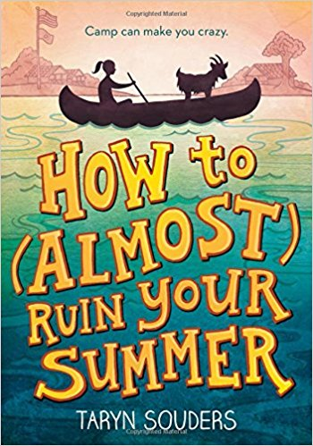
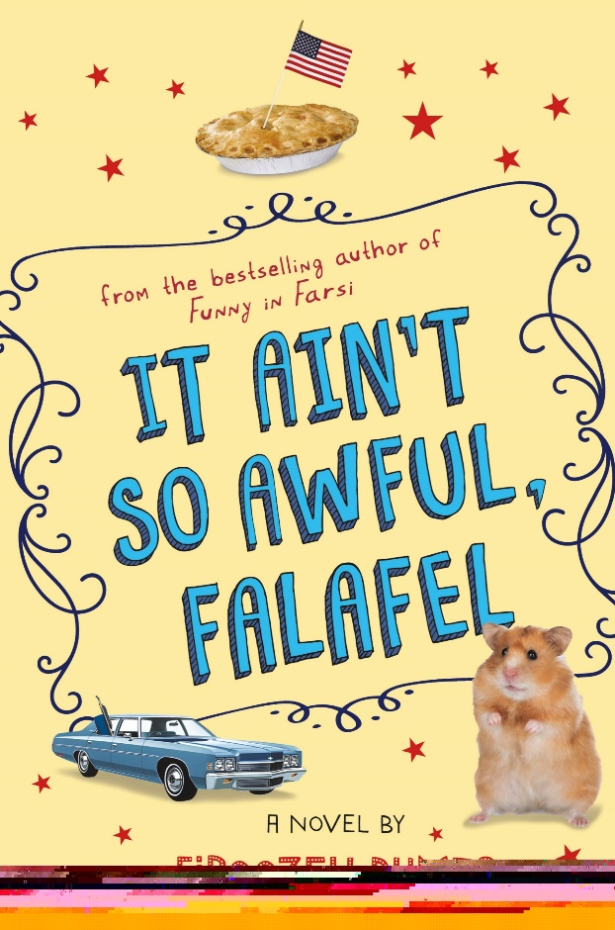
How to (Almost) Ruin Your Summer by Taryn Souders
Chloe McCorkle is willing to do anything in order to avoid having to ride her hot pink “Dora the Explorer” bike to her first day of middle school --- well, anything but go to summer camp, that is. Unfortunately, when you’re 11-years-old, what mom and dad says goes. Leaving behind her friends, her stuffed elephant (too dorky to bring to camp) and her plans to get rich babysitting, Chloe begrudgingly heads to Camp Minnehaha for what she is sure is going to be the worst two weeks ever.
It Ain’t So Awful, Falafel by Firoozeh Dumas
Cindy, a middle schooler whose given name is Zomorod, moves to a new California city with her Iranian parents. Set in the late 70’s / early 80’s, Cindy has to learn to navigate middle school, balance new friendships, and stay true to her parents and culture all in the face of anti-Iranian racism after the Iran hostage crisis.

Slide 5
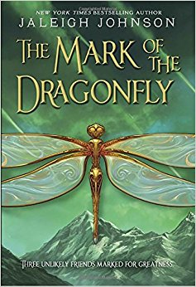
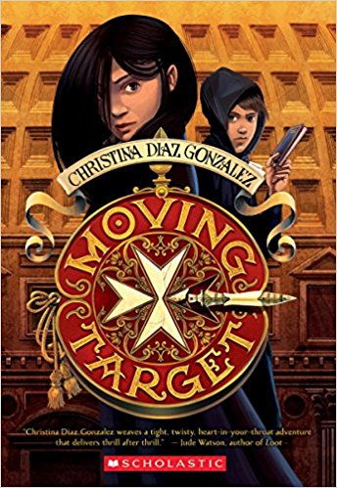
The Mark of the Dragonfly by Jaleigh Johnson
Piper has never seen the Mark of the Dragonfly but she knows it means protection. When Piper finds a girl amongst the wreckage of a caravan with the mark she knows she will be rewarded. But can she survive the journey to the Dragon Territories?
Moving Target by Christina Diaz Gonzalez
Cassie Arroyo is a twelve year old girl who lives and goes to school in Rome. Her life is turned upside down when her father is shot by members of a secret organization, the Hastati. Cassie discovers that she is a descendent of a line of people who can use the Spear of Destiny to alter the future.

Slide 6
The Nerdy Dozen by Jeff Miller
When classified U.S. military intelligence is compromised, teenage gamers must save the day. Taken in the middle of the night by the Air Force, Neil Andertol and eleven other gaming whizzes train to fly stealth fighter jets that have top-secret invisibility technology. It turns out that mastering the controls is the easy part. Can Neil face down a bully, a scorned billionaire, and wild ostriches before it’s game over?
The Nest by Kenneth Oppel
Steve’s baby brother is very sick and everyone is worried. At night in his dreams, Steve is visited by what he thinks is an angel who convinces him that she will make the baby perfect as long as he agrees to help. Steve soon discovers that the angel is really a queen wasp from the colony outside his house who, in fixing the baby, plans to make a replacement baby instead.

Slide 7
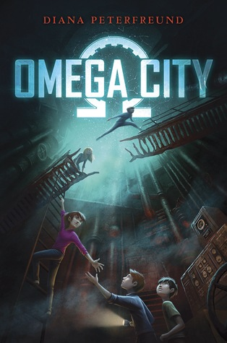
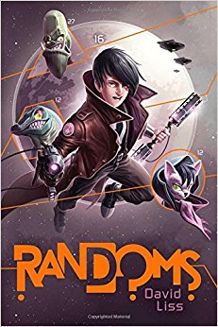
Omega City by Diana Peterfreund
Gillian’s father seems to be a crackpot, with his conspiracy theories about the Cold War era scientist, Dr. Underberg and his plans for an underground world prepared for the survival of the human race. Clues lead Gillian, her brother and their space-nerd friend, Howard to a hidden world created by Dr. Underberg decades ago. They must learn what they can and find a way out before the people who want the secrets buried find THEM.
Randoms by David Liss
Zeke Reynolds is randomly chosen to represent planet Earth in the application to enter the Confederation of United Planets. While on the the space station, Zeke begins to unravel a conspiracy.

Slide 8
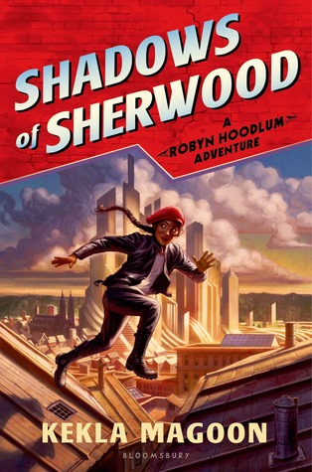
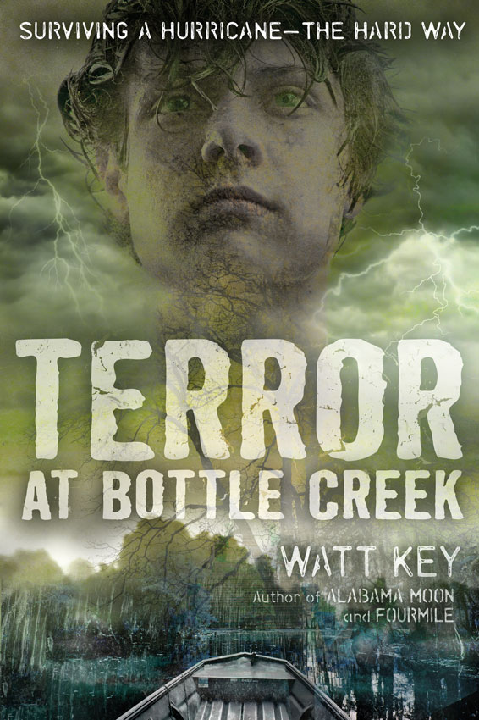
Shadows of Sherwood by Kekla Magoon
The night her parents disappear, twelve-year-old Robyn Loxley must learn to fend for herself. Her home has been taken over by a harsh governor. After fleeing for her life, Robyn has no choice but to join a band of strangers-misfit kids, each with their own special talent for mischief. Setting out to right the wrongs of Crown's merciless government, they take their outlaw status in stride. But Robyn can't rest until she finds her parents. As she pieces together clues Robyn learns that her destiny is tied to the future of Nott City in ways she never expected.
Terror at Bottle Creek by Watt Key
In this gritty, realistic wilderness adventure, thirteen-year-old Cort is caught in a battle against a Gulf Coast hurricane. Cort's father is a local expert on hunting and swamp lore in lower Alabama who has been teaching his son everything he knows. But when a deadly Category 3 storm makes landfall, Cort must unexpectedly put his all skills-and bravery-to the test. Amid miles of storm-thrashed wetlands filled with dangerous, desperate wild animals, it's up to Cort to win-or lose-the fight for their lives

Slide 9
The War That Saved My Life by Kimberly Brubaker Bradley
Born with a club foot, nine-year-old Ada is locked in a room and can only gaze out the window at her younger brother playing with his friends in the London streets. Fears about bombs dropping, children are sent to the countryside to keep them safe. Together they join lonely, recluse Mrs. Smith, the only one to volunteer to take care of them. Ada cannot always read her benefactor’s intentions, but she learns to trust, just as she learns to ride a horse named Butter. From victor to victorious, especially after the battle of Dunkirk, this is a story of one girl’s courage.
Sunshine

